Slide 1
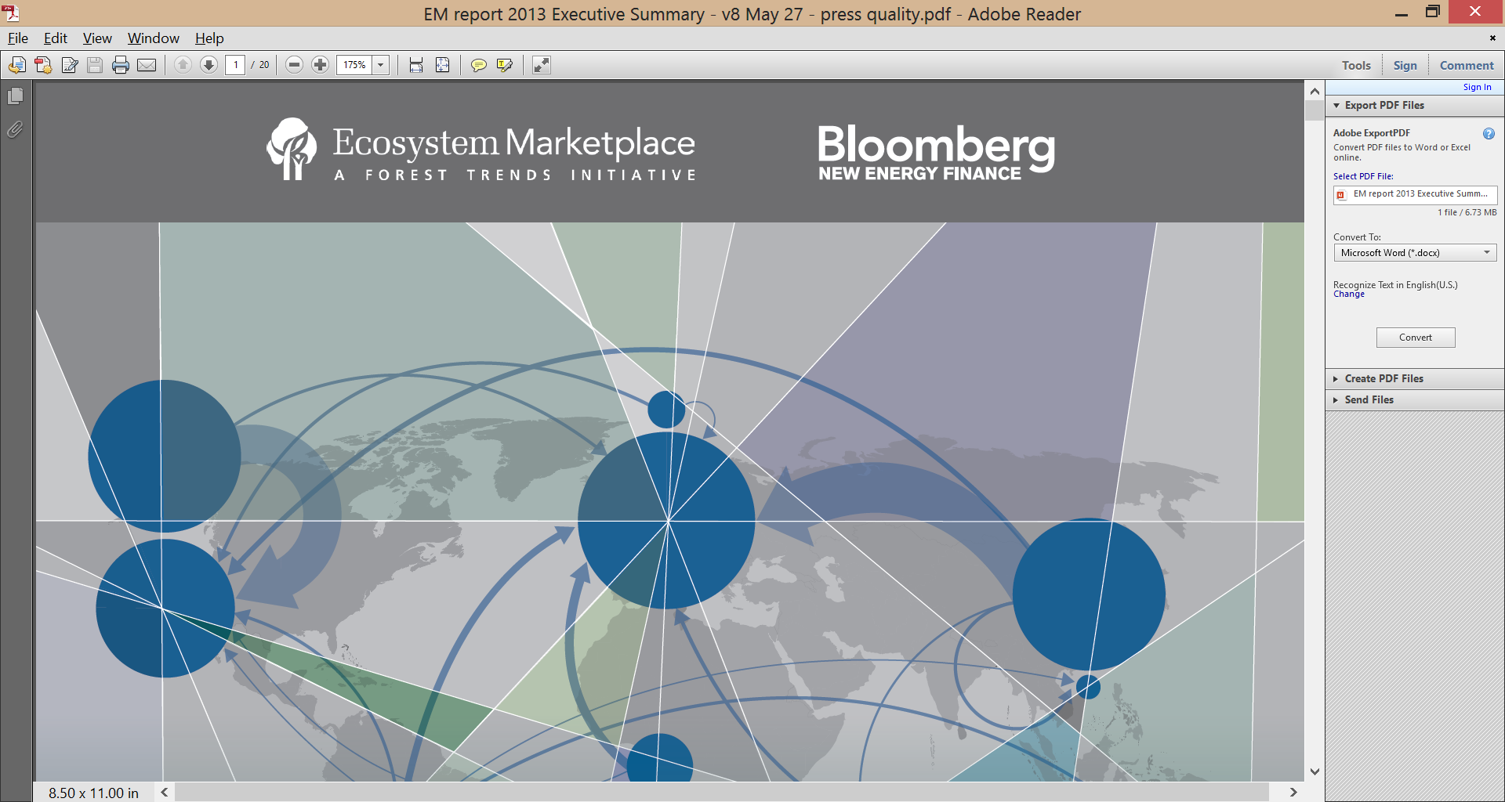
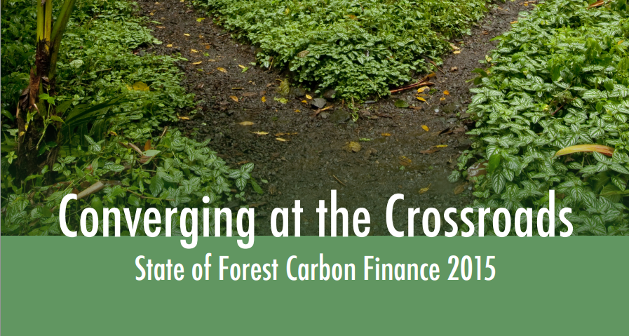
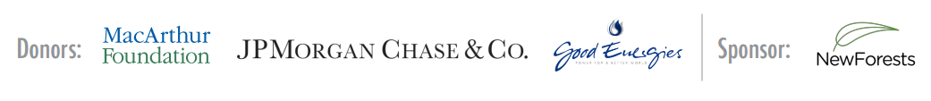

Slide 2

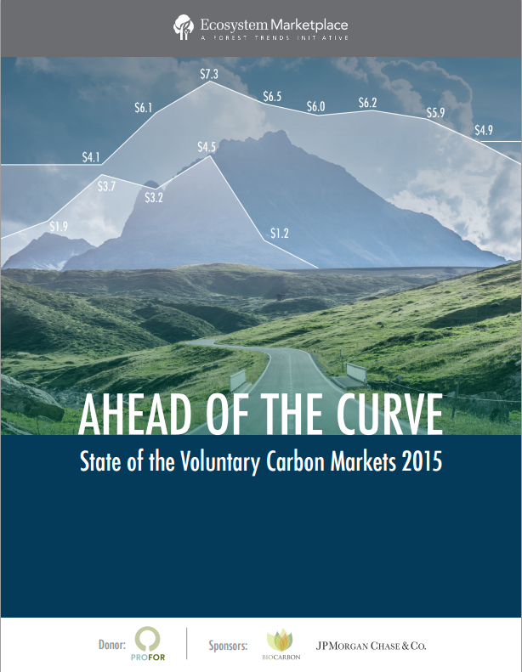

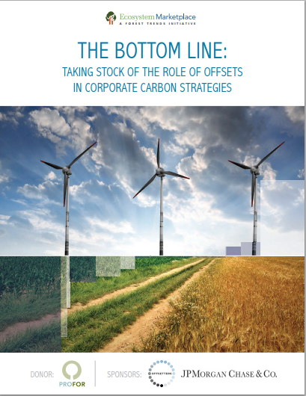
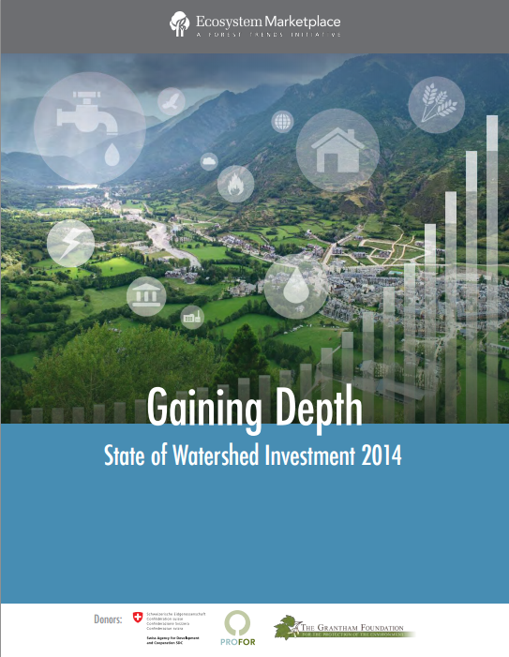
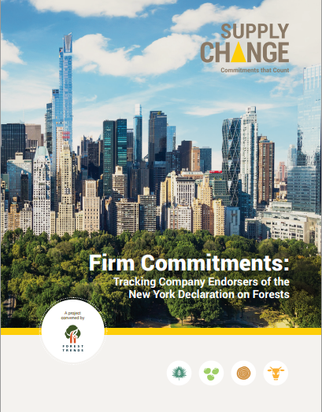
ECOSYSTEM MARKETPLACE: A global source for news, data and analytics around environmental markets and payments for ecosystem services

Slide 3
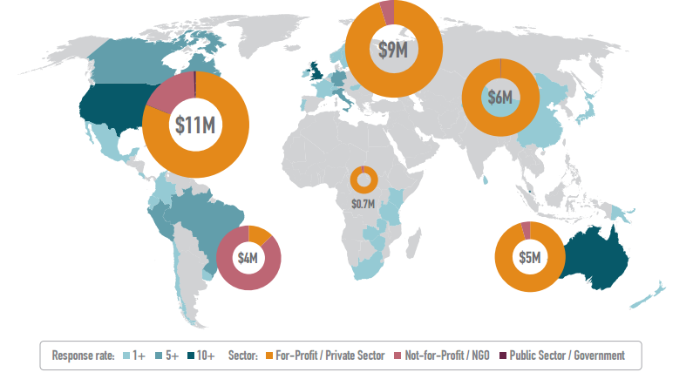
Methodology: Global annual survey of hundreds of forest carbon project developers and offset retailers; 144 projects reported detailed data
Response Rate by Country, Contracted Volume by Developers’ Headquarters Region, and Market Share by Suppliers’ Profit Status
Note: Based on 34.4 MtCO2 e in contracted volume reported by 144 forest carbon offset project developers, retailers, and jurisdictional initiatives in 2014.
Source: Forest Trends’ Ecosystem Marketplace, State of Forest Carbon Finance 2015

Slide 4
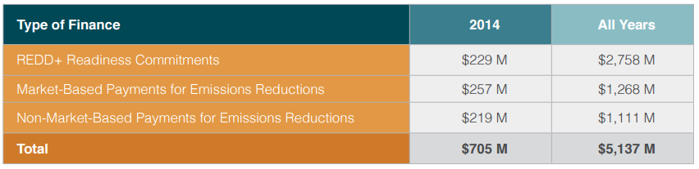
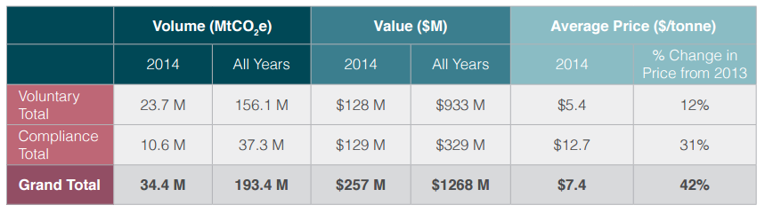
2014 Demand by the Numbers: $476 M committed in 2014 to pay for emissions reductions; $257 M of that through carbon market transactions
Summary of Types of Forest Carbon Finance, 2014 and All Years
Overview of Market-Based Payments for Emissions Reductions in 2014 and Over Time

Slide 5
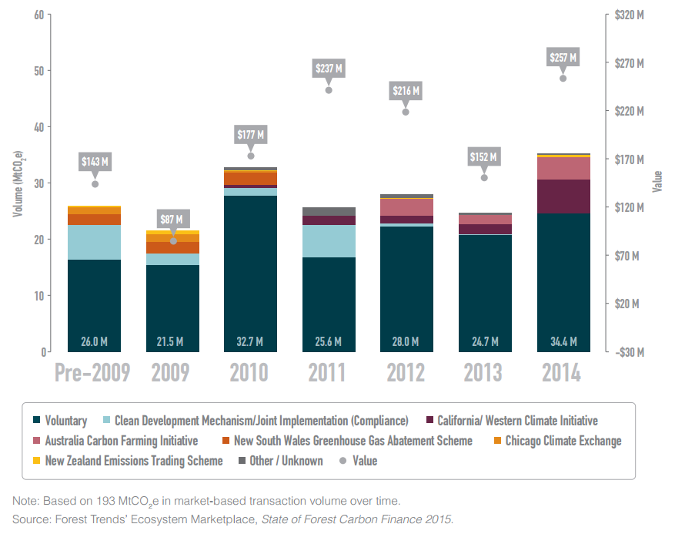
Record Year: Demand for forest carbon offsets reached an all-time high of 34.4 Mt, with 10.6 Mt transacted on compliance markets
Historical Market-Based Payments for Forest-Based Emissions Reductions: Transaction Volumes and Values
Note: Based on 193 MtCO2 e in market-based transaction volume over time.
Source: Forest Trends’ Ecosystem Marketplace, State of Forest Carbon Finance 2015.

Slide 6
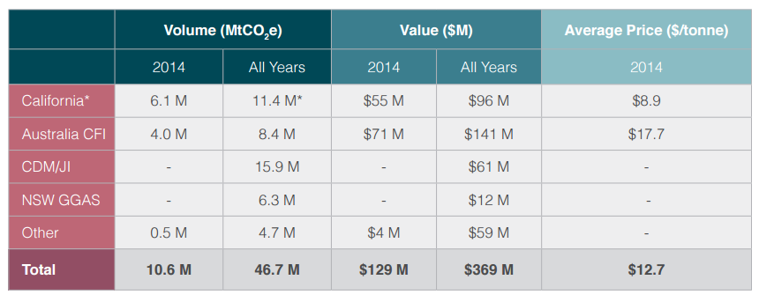
Compliance Markets: Forestry most transacted offset type on California carbon market; Australian buyers “true up” before carbon tax repeal
Compliance Markets for Forest Carbon in 2014 and Over Time

Slide 7
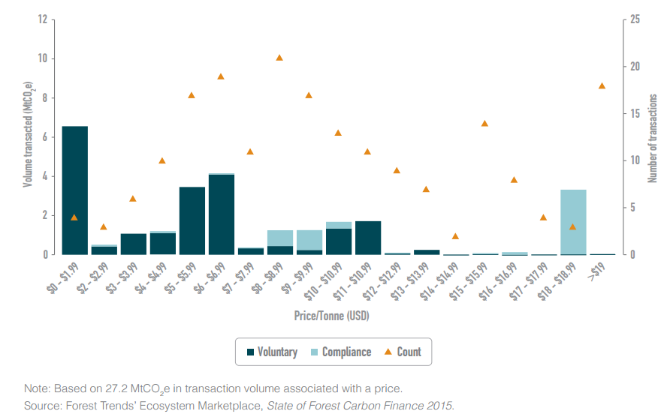
Offset Prices: Average price on voluntary markets recovered slightly to $5.4/tonne in 2014; compliance prices averaged $12.7/tonne
Volume Transacted by Offset Price and Market
Note: Based on 27.2 MtCO2 e in transaction volume associated with a price.
Source: Forest Trends’ Ecosystem Marketplace, State of Forest Carbon Finance 2015.

Slide 8
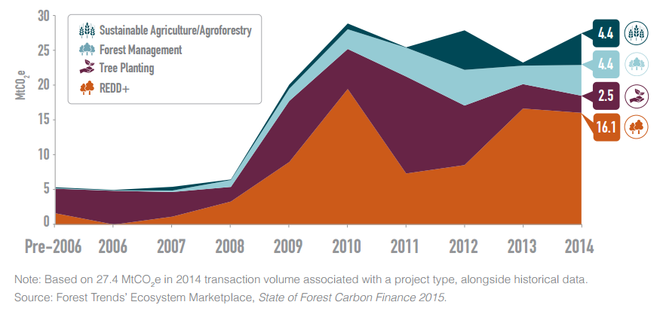
Project Types: REDD+ is most sought-after offset type; demand for sustainable agriculture and forest management tonnes increased
Volume of Demand for Forest Carbon Offsets by Project Type, All Markets, Historical
Note: Based on 27.4 MtCO2 e in 2014 transaction volume associated with a project type, alongside historical data.
Source: Forest Trends’ Ecosystem Marketplace, State of Forest Carbon Finance 2015.

Slide 9
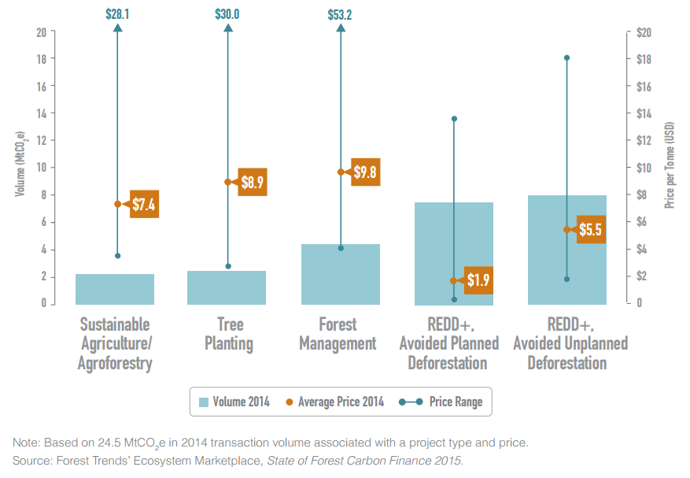
Prices by Project Type: REDD offsets averaged $3.7/tonne, with economies of scale; temperate-forest-focused project types priced higher
Transacted Volume and Average Price by Project Type, 2014
Note: Based on 24.5 MtCO2 e in 2014 transaction volume associated with a project type and price.
Source: Forest Trends’ Ecosystem Marketplace, State of Forest Carbon Finance 2015.

Slide 10
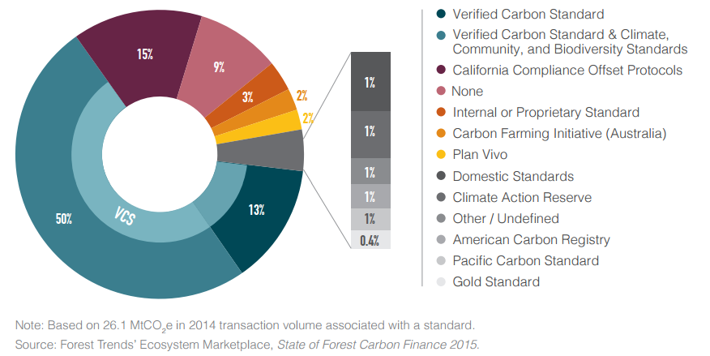
Standards: 91% of offsets transacted use a third-party carbon standard; the Verified Carbon Standard held 63% market share in 2014
Market Share by Independent Standard, 2014
Note: Based on 26.1 MtCO2 e in 2014 transaction volume associated with a standard.
Source: Forest Trends’ Ecosystem Marketplace, State of Forest Carbon Finance 2015.

Slide 11
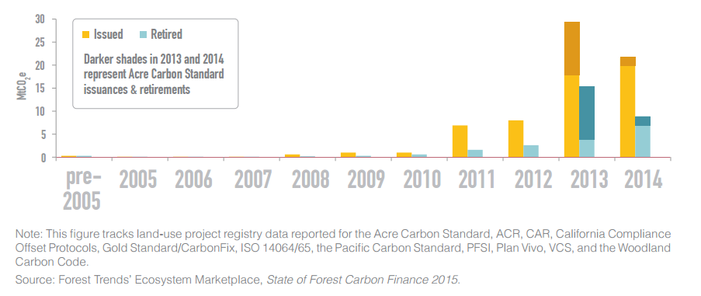
Supply Dynamics: Offset issuances have grown rapidly, with 29.9 Mt issued in 2014; meanwhile 10.8 Mt of forest carbon offsets were retired last year
Historical Issued, Retired, and Transacted Offset Volumes
Note: This figure tracks land-use project registry data reported for the Acre Carbon Standard, ACR, CAR, California Compliance Offset Protocols, Gold Standard/CarbonFix, ISO 14064/65, the Pacific Carbon Standard, PFSI, Plan Vivo, VCS, and the Woodland Carbon Code.
Source: Forest Trends’ Ecosystem Marketplace, State of Forest Carbon Finance 2015.

Slide 12
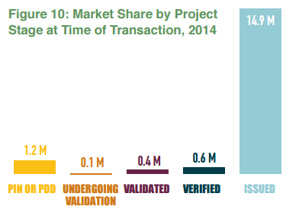
Transaction Timing: 87% of 2014 transactions occurred after offset issuance, on a “spot” basis
Market Share by Project Stage at Time of Transaction, 2014
Note: Based on 17.2 MtCO2 e in transaction volume associated with a project stage.
Source: Forest Trends’ Ecosystem Marketplace, State of Forest Carbon Finance 2015.

Slide 13
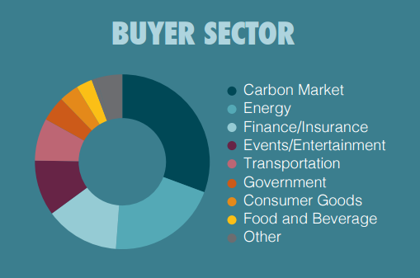
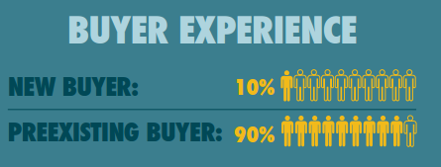

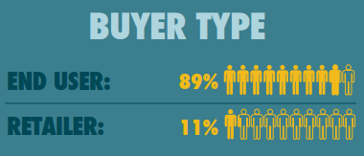
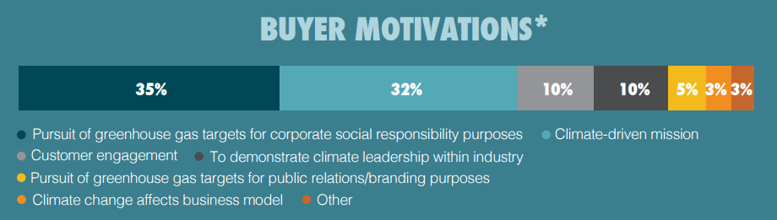
Buyers: 93% private sector actors from at least 26 countries; however new market entrants are few and offset supply outpaces voluntary demand
Buyer Analysis by Sector, Type, Experience, and Motivation, 2014
Notes: Based on 187 transactions associated with buyer sector, 232 transactions associated with buyer type, 58 transactions associated with buyer experience, and 130 transactions associated with buyer motivations, as described by survey respondents. *Percentages may not add up to 100% due to rounding.
Source: Forest Trends’ Ecosystem Marketplace, State of Forest Carbon Finance 2015.

Slide 14
Demand Developments: All eyes are on Paris, but compliance markets, supply chain initiatives, and internal carbon pricing could drive demand
Compliance Markets:
    Healthy demand in California; state regulators may consider REDD in 2016. Offset-inclusive carbon policy also launched or launching in China, Korea, South Africa.
Aviation Negotiations:
  International Civil Aviation Organization plans to cap emissions at 2020 levels. They’ll net a market-based mechanism to achieve the target.
The New York Declaration on Forests:
  Private sector signatories representing $1.36 trillion in annual revenues have made commitments to reduce deforestation in their supply chains.
Internal Carbon Pricing:
  437 companies internally price carbon and 583 will within the next two years. Companies that internally price carbon are 5x more likely to offset.

Slide 15
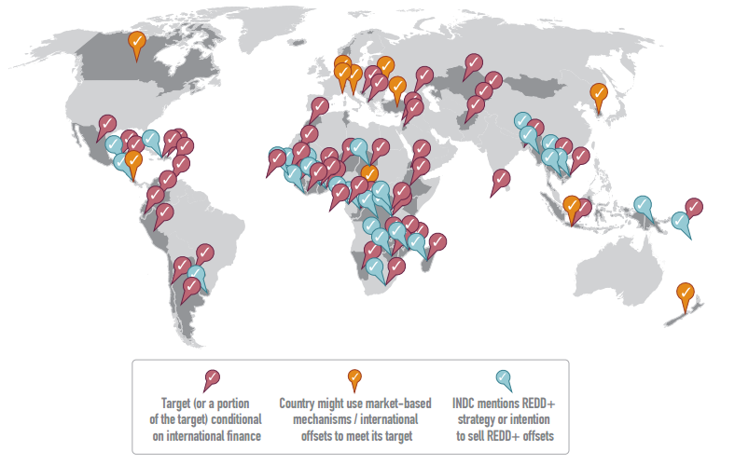
Towards Paris: 29 tropical forest countries’ climate plans include REDD+ and even more are “conditional” on international finance
The Role of Market-Based Mechanisms in Countries’ Submitted Intended Nationally Determined Contributions (INDCs)
Notes: Based on analysis of 122 INDCs submitted to the UNFCCC as of October 9, 2015. The International Emissions Trading Association’s INDC tracker summarizes the role of markets in the INDCs and is available here: https://docs.google.com/ spreadsheets/d/1YgIQiiucWW9vuDUAMeRstzzLxTXi6zFWtFVClqtRTe4/edit
Source: Forest Trends’ Ecosystem Marketplace, State of Forest Carbon Finance 2015

Slide 16
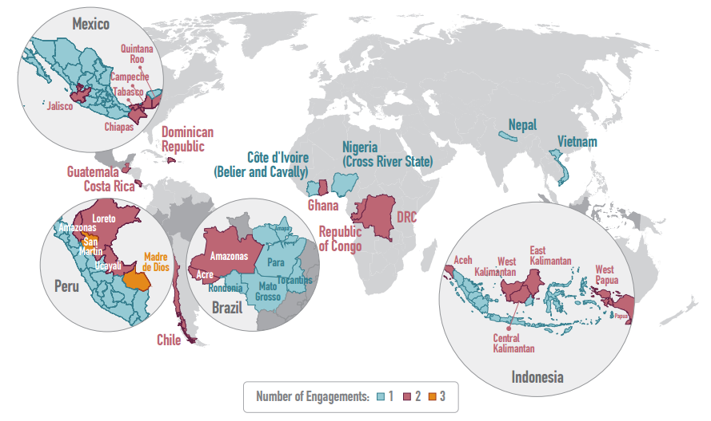
Projects and Programs: More than 100 forest carbon projects are within provinces, regions, or countries engaged in public sector REDD+ programs
Map of Public Sector REDD+ Programs Around the World
Note: Based on pilot initiatives tracked by Ecosystem Marketplace over the last six years.
Source: Forest Trends’ Ecosystem Marketplace, State of Forest Carbon Finance 2015.

Slide 17





Thank You: Support from sponsors, stakeholders and survey respondents enabled our most comprehensive report to date
Donors:
Sponsor:
Supporters:
CONTACT
Allie Goldstein, Senior Carbon Associate | Forest Trends’ Ecosystem Marketplace
agoldstein@ecosystemmarketplace.com | +1 202-446-1988

Slide 18
Extra slides

Slide 19
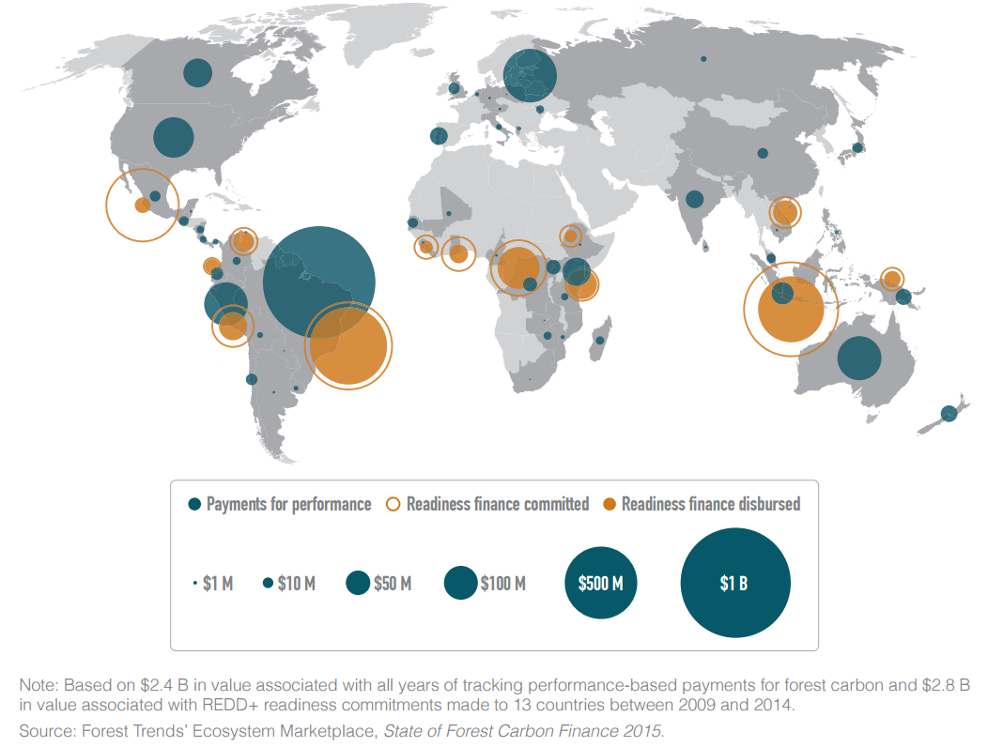
From Readiness to Results: Governments, companies, and individuals have committed a total of $5.1 B to keep forests standing
Comparison of Readiness Finance and Performance-Based Payments, All Years
Note: Based on 193 MtCO2 e in market-based transaction volume over time.
Source: Forest Trends’ Ecosystem Marketplace, State of Forest Carbon Finance 2015.

Slide 20
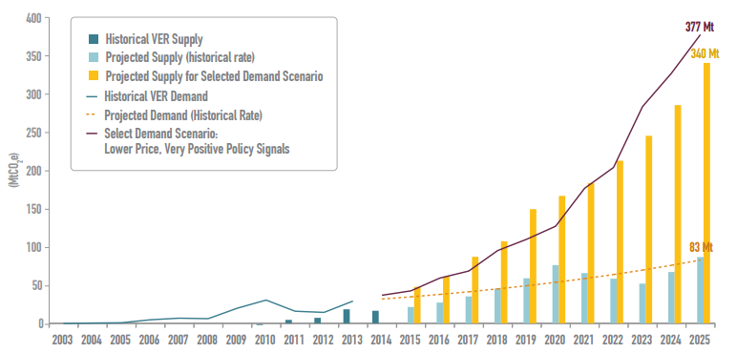
Future of the Voluntary Market: With “positive” or “very positive” policy signals, demand projected to reach a minimum of 106 Mt by 2025
Supply-and-Demand Projections for a “Lower Price, Very Positive Policy Signals” Scenario
Notes: Based on a decade’s worth of proprietary Ecosystem Marketplace forest carbon data. Full interactive model available at: http://theredddesk.org/markets-standards/analysis/forest-trends
Source: Forest Trends’ Ecosystem Marketplace, State of Forest Carbon Finance 2015.

Slide 21
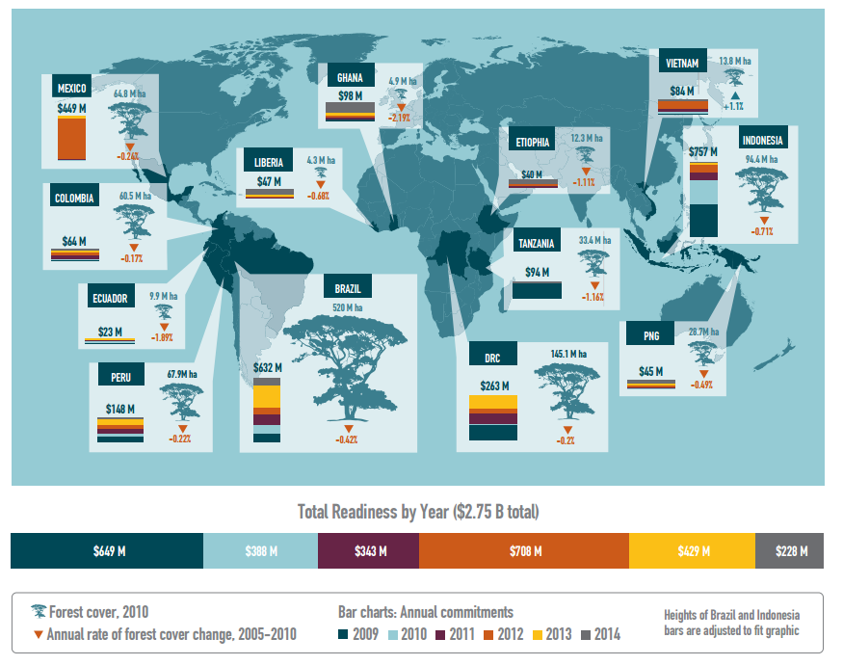
REDD Readiness: $2.8 B in “readiness” finance committed to 13 countries, with more than half going to Brazil and Indonesia
REDD Finance Committed and Disbursed in 13 Countries, 2009–2014
Notes: Based on $2.8 B in readiness finance committed to 13 REDD countries between 2009 and 2014. Annual deforestation rates are the latest available data from the Food and Agricultural Organization of the United Nations.
Source: Forest Trends’ Ecosystem Marketplace, State of Forest Carbon Finance 2015.

Slide 22
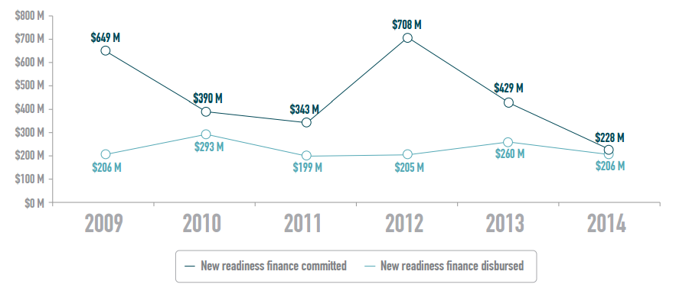
Disbursements: More than half of REDD+ readiness commitments have been disbursed, and donors are shifting towards results-based finance
Readiness Finance Committed and Disbursed by Year, 2009-2014
Note: Based on $2.8 B in readiness finance committed between 2009 and 2014.
Source: Forest Trends’ Ecosystem Marketplace, State of Forest Carbon Finance 2015.

Slide 23
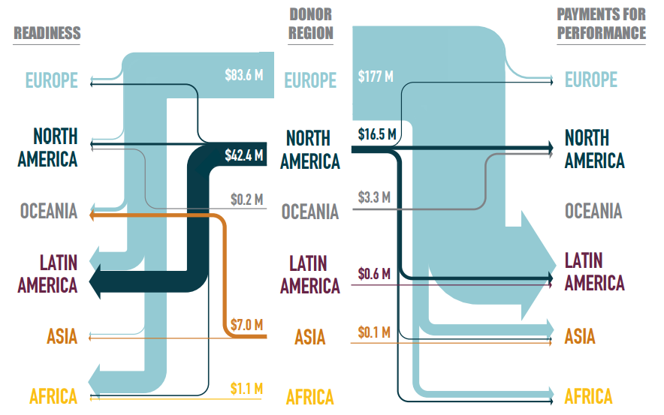
Funder Regions: Europeans behind 78% of 2014 forest carbon finance; Norway and Germany are top funders over time
Flow of Finance from Donor/Buyer Region to Recipient Region, 2014
Notes: Based on $134 M in REDD+ readiness finance associated with a donor region and $198 M in results-based payments associated with a buyer region in 2014. Results-based payment values are conservative and based only on transactions that traced both the supplier region and the buyer region.
Source: Forest Trends’ Ecosystem Marketplace, State of Forest Carbon Finance 2015.

Slide 24
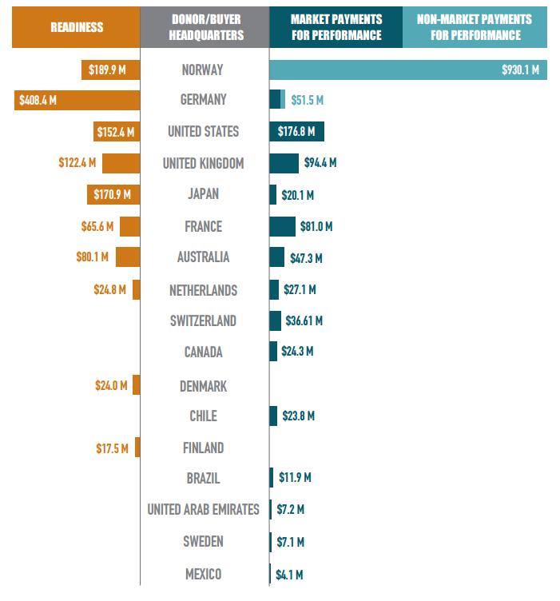
Funder Countries: Public sector finance for forest carbon is not necessarily creating the conditions for private sector, market-based payments
Comparison of Readiness and Results-Based Forest Carbon Finance by Top Donor/Buyer Countries, All Years
Note: Based on all REDD+ readiness finance associated with a donor country and results-based finance associated with a buyer country between 2011 (the earliest year for which country-level data is available) and 2014.
Source: Forest Trends’ Ecosystem Marketplace, State of Forest Carbon Finance 2015.

Slide 25
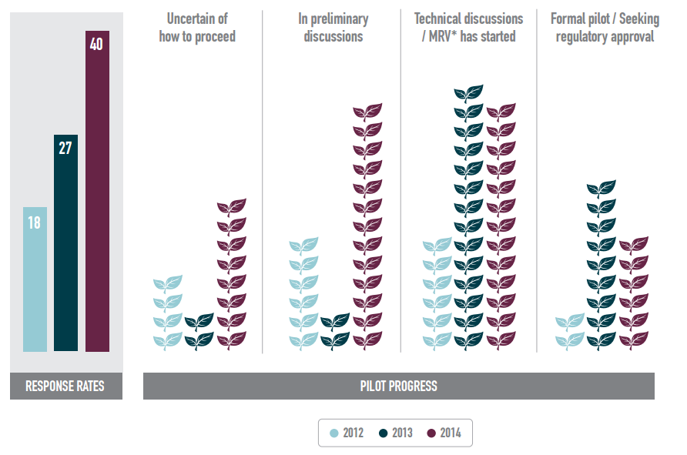
Nested Projects: Only 6 projects reported being “formal pilots”; another 26 are in preliminary or technical discussions with governments
Pilot Projects Reporting Progress Public Program Integration, 2012-2014
Notes: Based on 40 projects that reported nesting progress in 2014, 27 in 2013, and 18 in 2020. *MRV = Measuring, Reporting, and Verification. Source: Forest Trends’ Ecosystem Marketplace, State of Forest Carbon Finance 2015.

Slide 26
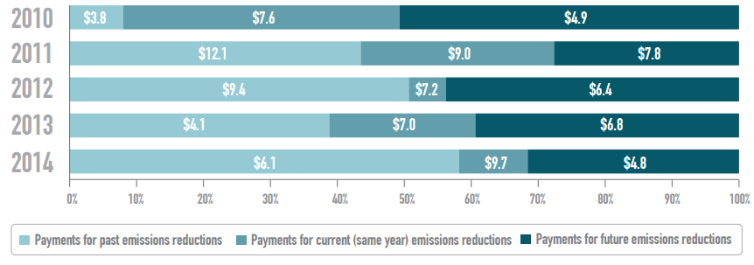
Offset Vintage: Less than one-third of 2014 market value invested in future emissions reductions as supply stacks up
Percentage of Offsets Transacted by Past, Current, and Future Vintages, 2010-2014
Note: Based on $651 M in payments for offsets associated with a vintage.
Source: Forest Trends’ Ecosystem Marketplace, State of Forest Carbon Finance 2015.

Slide 27
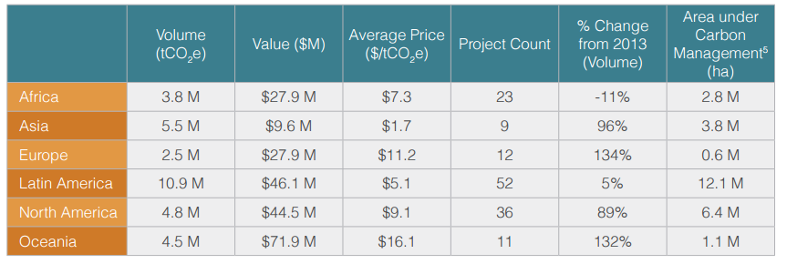
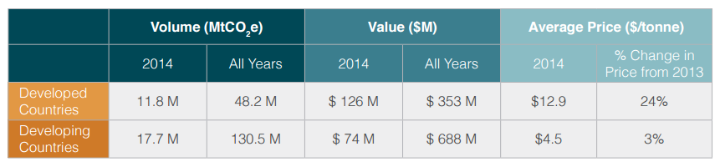
Project Location: Voluntary buyers seek 10.8 Mt from Latin America; most transaction volume from Peru and Brazil
Demand for Forest Carbon Offsets by Activity Location, 2014
Overview of Forest Carbon Results-Based Payments by Project Country’s Development Status

Slide 28
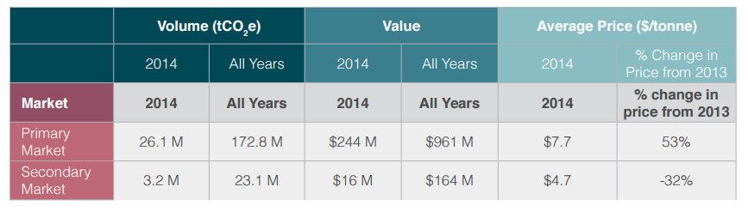
Primary and Secondary Markets: Retailers held 11% market share in 2014, selling at lower-than-average prices
Overview of Forest Carbon Results-based Payments by Primary Versus Secondary Market

Slide 29
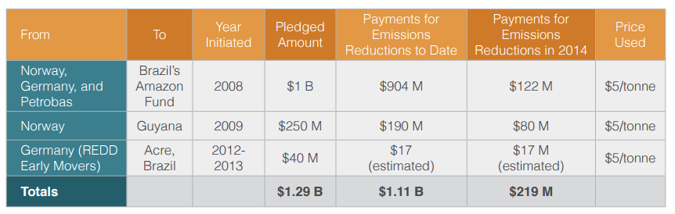
Non-Market Payments: $219 M in new finance went to pay for emissions reductions outside of market mechanisms in 2014
Non-Market Payments for Emissions Reductions

Slide 30
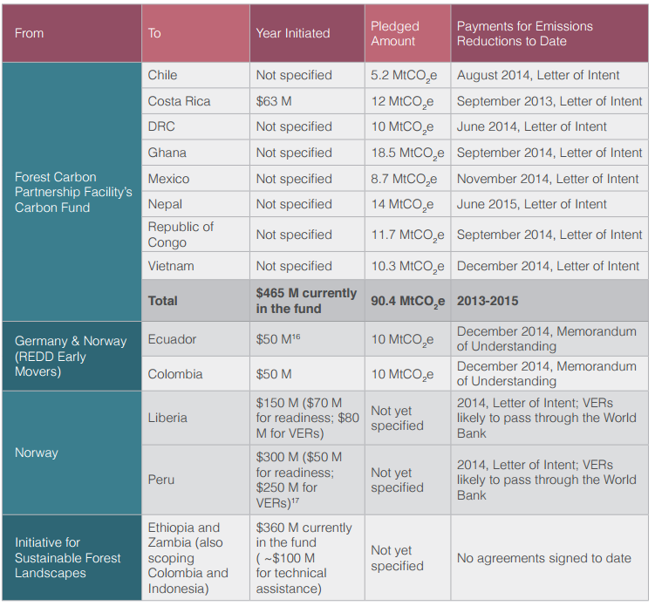
In the Pipeline: $1.2 B in pending pledges represents money “on the table” for tropical forest countries to reduce emissions from deforestation
Pending Non-Market-Based Payments for VERs

